Slide 1
JAVA THREADING

Slide 2
Nội dung
Khái niệm về lập trình song song & Java Thread
Thread class
  run, start methods
  yield, join
  sleep
Data sharing among thereads
Synchronization
  synchronized methods & objects
  wait/notify/notifyAll
  Conditions

Slide 3
Multi Thread Programming in Java
Resources
  API docs
    http://download.oracle.com/javase/6/docs/api/
      java.lang.Thread, java.lang.Runnable
      java.lang.Object, java.util.concurrent
  Tutorials
    http://download.oracle.com/javase/tutorial/essential/concurrency/index.html
    http://download.oracle.com/javase/tutorial/essential/concurrency/procthread.html
  Introduction to Java Threads
    http://www.javaworld.com/javaworld/jw-04-1996/jw-04-threads.html
  Thread safety
    http://en.wikipedia.org/wiki/Thread-safety
    http://www.javaworld.com/jw-08-1998/jw-08-techniques.html
Notes:
Contrast between a class with synchronization and a class without synchronization!! How many threads can call the methods at the same time on an instance?

Slide 4
java.lang.Thread
Two techniques to create threads in java
1) implementing the HP interface
  The Runnable interface should be implemented by any class whose instances are intended to be executed by a thread. The class must define a method, called run, with no arguments.
  invoke Thread constructor with an instance of this Runnable class
  See pages 162 and 164 in text for an example
2) extending Thread
  Define a subclass of java.lang.Thread
    Define a run method
  In another thread (e.g., the main), create an instance of the Thread subclass
    Then, call start method of that instance
Notes:
Don’t call run method directly.
Two methods to

Slide 5
Example 1
Create 2 threads from the Main, then start them
Threads will be instances of different thread sub-classes

Slide 6
Tạo luồng bằng cách kết thừa lớp Thread
class MyThreadA extends Thread {
public void run() { // entry point for thread
for (;;) {
System.out.println("hello world1");
}
}
}
class MyThreadB extends Thread {
public void run() { // entry point for thread
for (;;) {
System.out.println("hello world2");
}
}
}
public class Main1 {
public static void main(String [] args) {
MyThreadA t1 = new MyThreadA();
MyThreadB t2 = new MyThreadB();
t1.start();
t2.start();
// main terminates, but in Java the other threads keep running
// and hence Java program continues running
}
}

Slide 7
Kết quả chạy chương trình
hello world2
hello world2
hello world1
hello world2
hello world1
hello world2
hello world2
hello world1
hello world1
hello world1
hello world1
hello world2
hello world1
hello world1
hello world2
hello world2
hello world1
hello world1
hello world2
hello world2
hello world1
hello world1
hello world2
Notes:
Run on Mac OS X, 3/14/08
Sometimes in multithreaded programs, you see parts of the output more interspersed than this.

Slide 8
Example 2
Create 2 threads from the Main, then start them
Threads will be instances of the same thread sub-class
Use argument of constructor of new thread class to pass text name of thread, e.g., “thread1” and “thread2”
  Data member provides different data per thread (i.e., then name)
  A data member can also be used to share data
Notes:
Have the students work this example.

Slide 9
Các luồng khác nhau được cài đặt bằng cùng một class
class MyThread extends Thread {
private String name;
public MyThread(String name) {
this.name = name;
}
public void run() {
for (;;) {
System.out.println(name + ": hello world");
}
}
}
public class Main2 {
public static void main(String [] args) {
MyThread t1 = new MyThread("thread1");
MyThread t2 = new MyThread("thread2");
t1.start(); t2.start();
}
}

Slide 10
Kết quả chạy chương trình
thread2: hello world
thread2: hello world
thread2: hello world
thread2: hello world
thread2: hello world
thread2: hello world
thread2: hello world
thread2: hello world
thread2: hello world
thread2: hello world
thread2: hello world
thread2: hello world
thread2: hello world
thread2: hello world
thread2: hello world
thread1: hello world
thread2: hello world
thread1: hello world
thread2: hello world
thread2: hello world
thread1: hello world
thread2: hello world
thread2: hello world
See the variation in output: This variation in output is called a “race condition” (often race conditions are bugs in programs)
Notes:
See the variation in output.

Slide 11
java.lang.Thread
public static void yield();
  Method of java.lang.Thread
  Thread gives up CPU for other threads ready to run

Slide 12
public static void yield();
class MyThread extends Thread {
private String name;
public MyThread(String name) {
this.name = name;
}
public void run() {
for (;;) {
System.out.println(name + ": hello world");
yield();
}
}
}
public class Main3 {
public static void main(String [] args) {
MyThread t1 = new MyThread("thread1");
MyThread t2 = new MyThread("thread2");
t1.start(); t2.start();
}
}

Slide 13
Some Output
thread1: hello world
thread2: hello world
thread1: hello world
thread2: hello world
thread1: hello world
thread2: hello world
thread1: hello world
thread2: hello world
thread1: hello world
thread2: hello world
thread1: hello world
thread2: hello world
thread1: hello world
thread2: hello world
thread1: hello world
thread2: hello world
thread1: hello world
thread2: hello world
thread1: hello world
thread2: hello world
thread1: hello world
thread2: hello world
thread1: hello world
Notice the alternation of output
Notes:
Run on Mac OS X, 3/14/08

Slide 14
More Thread Members: join
Thread #1
Thread #2
public final void join();
  MyThread t1 = new MyThread("thread1");
  t1.start();
  t1.join();
  Wait until the thread is “not alive”
  Threads that have completed are “not alive” as are threads that have not yet been started
Thread #2.join()
Thread #2 finish
Notes:
final on a method indicates it can’t be overridden

Slide 15
Join Example
class MyThread extends Thread {
public void run() {
for (int i=0; i < 1000; i++) {
System.out.println("hello world1");
}
}
}
public class Main4 {
public static void main(String [] args) {
MyThread t1 = new MyThread();
t1.start();
try {
t1.join(); // wait for the thread to terminate
} catch (InterruptedException e) {
System.out.println("ERROR: Thread was interrupted");
}
System.out.println("Thread is done!");
}
}

Slide 16
Some output
…
hello world1
hello world1
hello world1
hello world1
hello world1
hello world1
hello world1
hello world1
hello world1
hello world1
hello world1
hello world1
hello world1
hello world1
hello world1
hello world1
hello world1
hello world1
hello world1
hello world1
hello world1
Thread is done!

Slide 17
sleep(long millis)
public static void sleep(long millis)
throws InterruptedException;
Makes the currently running thread sleep (block) for a period of time
The thread does not lose ownership of any monitors.
InterruptedException - if another thread has interrupted the current thread.

Slide 18
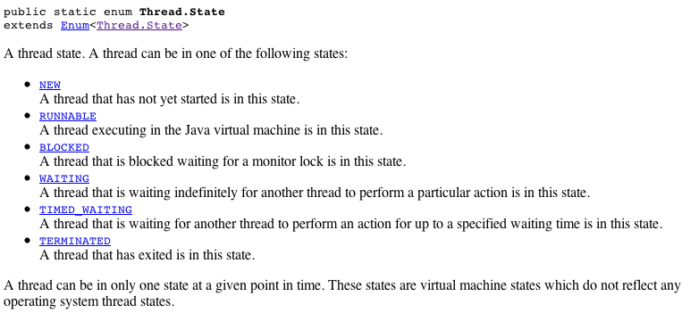
Thread State
public Thread.State getState()
  Returns the state of this thread. This method is designed for use in monitoring of the system state, not for synchronization control
http://java.sun.com/javase/6/docs/api/java/lang/Thread.State.html

Slide 19
Thread Scheduling
public final void setPriority(int newPriority);
public final int getPriority();
public static final int MAX_PRIORITY
  // on my system: 10; Mac OS X 2/21/05
public static final int MIN_PRIORITY
  // on my system: 1; Mac OS X 2/21/05
Scheduling
  Priority inherited from parent, but can be changed
  Higher priority threads generally run before lower priority threads
  For equal priority threads, best to call yield() intermittently to handle JVM’s with user-level threading (i.e., no time-slicing)
Notes:
10 and 1 were obtained on Mac OS X 2/21/05

Slide 20
SHARING DATA

Slide 21
Sharing Data Across Java Threads
Consider the situation where a parent thread wants to pass data to a child thread
  e.g., so that child can change data and parent can have access to the changed data
How can this be done?
Can pass an object instance to the child thread constructor, and retain that object instance in a data member

Slide 22
class SharedData {
public int a = 0;
public String s = null;
public SharedData() {
a = 10;
s = "Test";
}
}
class MyThread extends Thread {
private SharedData m_data = null;
public MyThread(SharedData data) {
m_data = data;
}
public void run() {
for (;;) {
m_data.a++;
}
}
}

Slide 23
public class Main5 {
public static void main(String [] args) {
SharedData data = new SharedData();
MyThread t1 = new MyThread(data);
t1.start();
for (;;) {
data.a--;
}
}
}
If we have multiple threads accessing this shared data, how do we synchronize access to ensure it remains in a consistent state?
Notes:
Of course, part of this depends on how we define “consistent state”.

Slide 24
Basic Tools for Synchronization
Synchronized methods
Synchronized objects
Methods
  wait
  notify
  notifyAll
Also should talk about condition variables in Java

Slide 25
Synchronized Methods: Monitors
synchronized keyword used with a method
  E.g.,
    public synchronized void SetValue() {
    // Update instance data structure.
    // When the thread executes here, it exclusively has the monitor lock
    }
  Provides instance-based mutual exclusion
    A lock is implicitly provided-- allows at most one thread to be executing the method at one time
  Used on a per method basis; not all methods in a class have to have this
    But, you’ll need to design it right!!

Slide 26
Difference: Synchronized vs. Non-synchronized
Class with synchronized methods
  How many threads can access the methods of an object?
Class with no synchronized methods
  How many threads can access the methods of an object?
Notes:
First: 1
Second: N – as many as want to

Slide 27
Example
Construct a queue (FIFO) data structure that can be used by two threads to access the queue data in a synchronized manner
  Producer thread: Adds data into queue
  Consumer thread: Removes data from queu
For one instance of the queue, only one thread should be able to modify the queue, i.e., we should have mutual exclusion on methods of one instance of the queue

Slide 28
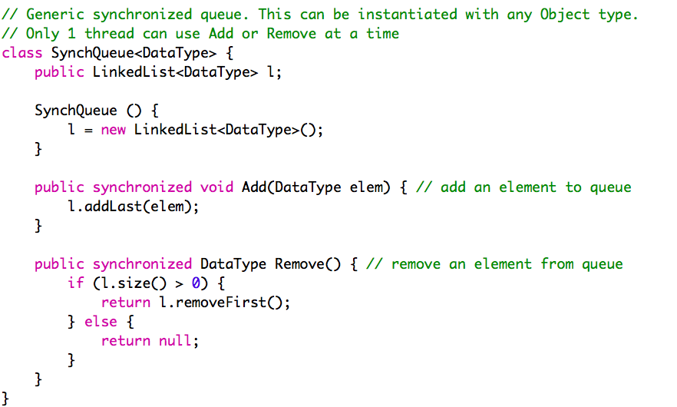

Slide 29
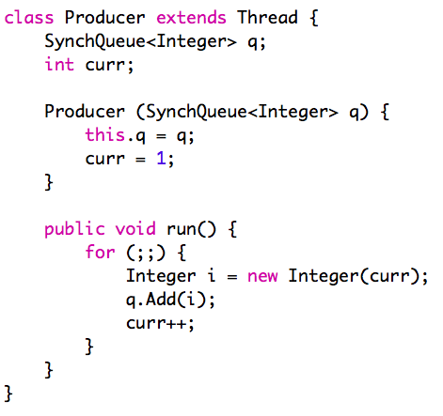
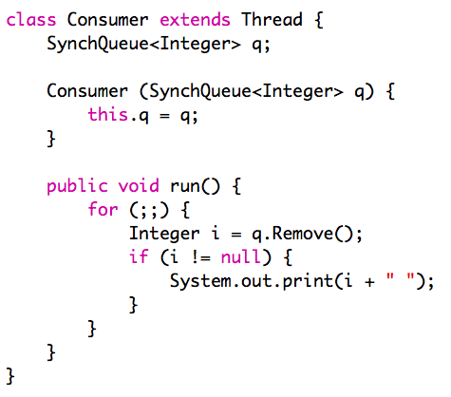
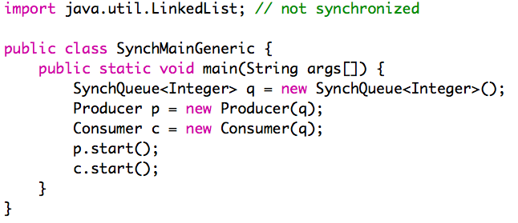

Slide 30
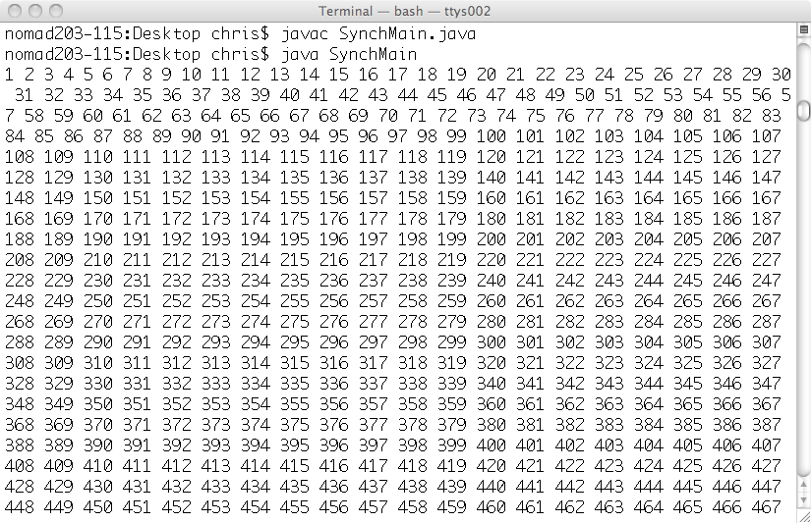
Let’s run this and see what happens

Slide 31


Slide 32
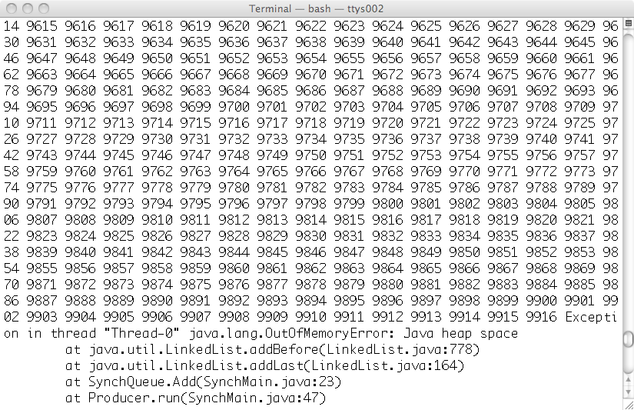
Ooops! What happened?

Slide 33
This implementation has a problem! The Consumer prints, which slows it down a LOT, and thus the producer is faster, and thus the producer fills up the queue, and causes heap space to run out!!
This is a kind of race condition
  The results depend on the speed of execution of the two processes
Would like to alter this program to limit the maximum number of items that are stored in the queue.
Goal: have the producer block (wait) when the queue reaches some fixed size limit

Slide 34
Also
Better to have the Remove block (wait) when the queue is empty
I.e., presently we are doing a “busy wait” (also called polling)
We are repeatedly checking the queue to see if it has data, and using up too much CPU time doing this
Notes:
See also:
http://java.sun.com/docs/books/tutorial/collections/implementations/queue.html
java.util.concurrent.LinkedBlockingQueue<E>
http://java.sun.com/j2se/1.5.0/docs/api/java/util/concurrent/BlockingQueue.html

Slide 35
wait method (see also java.lang.Object)
Does a blocking (not busy) wait
Relative to an Object
  E.g., Used within a synchronized method
Releases lock on Object and waits until a condition is true
  Blocks calling process until notify() or notifyAll() is called on same object instance (or exception occurs)
Typically used within a loop to re-check a condition
wait(long millis); // bounded wait

Slide 36
notify and notifyAll methods
(see also java.lang.Object)
Stop a process from waiting– wakes it up
Relative to an Object
  E.g., Used within a synchronized method
Wakes up a blocked thread (notify) or all blocked threads (notifyAll)
  One woken thread reacquires lock; The awakened thread will not be able to proceed until the current thread relinquishes the lock on this object.
For notify, if more than one thread available to be woken, then one is picked

Slide 37
Typical use of wait within a synchronized method
while (condition not true) {
try {
wait(); // this.wait();
} catch {
System.out.println(“Interrupted!”);
}
}
// After loop, condition now true & thread
// has monitor lock for this object instance

Slide 38
Example
Extend the example from before:
  a queue (FIFO) data structure that can be used by two threads to access the queue data in a synchronized manner
This time, use wait & notify to block the Producer thread if the queue is full, and block Consumer thread if the queue is empty

Slide 39
Re-checking Monitor Conditions
wait/notify
  After receiving a notify, a process waiting on a condition may not be next to gain access to monitor (to the data)
    E.g., occurs if notifyAll used
  Process may need to re-check the conditions upon which it was waiting
An “awakened thread will compete in the usual manner with any other threads that might be actively competing to synchronize on this object; for example, the awakened thread enjoys no reliable privilege or disadvantage in being the next thread to lock this object.” (http://java.sun.com/j2se/1.5.0/docs/api/)

Slide 40
InterruptedException
Wait can be woken by the exception, I.e., for reasons other than notify
Sometimes this can be handled as part of the process of re-checking conditions
There is another way to handle it too
Notes:
See http://java.sun.com/j2se/1.5.0/docs/api/java/lang/Object.html#wait()
for reasons why wait can be woken
“if another thread interrupted the current thread before or while the current thread was waiting for a notification. The interrupted status of the current thread is cleared when this exception is thrown.”
See also: http://java.sun.com/j2se/1.5.0/docs/api/java/lang/Thread.html#interrupt()
Threads can receive interrupted exception if they don’t have the monitor lock!!

Slide 41
Exception in Wait
// In a synchronized method
// check your condition, e.g., with a semaphore
// operation, test “value” member variable
if /* or while */ (/* condition */) {
boolean interrupted;
do {
interrupted = false;
try {
wait();
} catch (InterruptedException e) {
interrupted = true;
}
} while (interrupted);
}
Only allows release from wait caused by notify or notifyAll

Slide 42
Synchronized Blocks
Synchronized methods
  Implicitly lock is on this object
Synchronized blocks
  lock on an arbitrary, specified object
  similar to condition variables in monitors
  but need to have a synchronized block around an object before wait/notify used
  use wait/notify on the object itself

Slide 43
Syntax
synchronized (object) {
// object.wait()
// object.notify()
// object.notifyAll()
}
For example, this allows you to synchronize just a few lines of code, or to synchronize on the basis of an arbitrary object

Slide 44
Another Example
Suppose in a Global File Table, suppose that per open file you keep an Object Lock;
you can then use a synchronized block to make sure that some operations only get done in a mutually exclusive manner on the file
synchronized (file[i].Lock) {
// if we get to here we’re the only one
// accessing file i
}

Slide 45
Conditions
Java interface:
  http://download.oracle.com/javase/6/docs/api/java/util/concurrent/locks/Condition.html
Let’s you have multiple independent wait events for a monitor
So, have one monitor lock, but can wait within the monitor for more than one reason
Use await/signal (not wait/notify)
Also: Must have explicit lock (don’t use synchronized keyword)
Lock monitor as very first thing you do
Unlock monitor as very last thing you do

Slide 46
END!

